Slide 1








OpiTrack: A Wearable-based Clinical Opioid Use Tracker with Temporal Convolutional Attention Networks
Bhanu Teja Gullapalli¹, Stephanie Carreiro², Brittany P Chapman², Deepak Ganesan¹,
Jan Sjoquist², Tauhidur Rahman¹
¹Laboratory for Mobile Sensing and Ubiquitous Computing (MOSAIC),
University of Massachusetts Amherst
²Division of Medical Toxicology, Department of Emergency Medicine
University of Massachusetts Medical School
Notes:
We appreciate the opportunity to present our paper “OpiTrack: A Wearable-based Clinical Opioid Use Tracker with Temporal Convolutional Attention Networks”. This work was a collaborative effort between UMass Amherst Department of Computer Science and the UMass Medical School Division of Medical toxicology. My name is Bhanu Teja Gullapalli, phd student at Umass Amherst. Today Dr. Stephanie Carreiro and I will jointly present our work.

Slide 2

Opioid physiologic effects
Pain Relief
Sedation
Euphoria
Notes:
Opioids are a class of drug that bind to receptors in the brain and nervous system. In addition to providing effective pain relief, they have a number of other physiologic effects including euphoria and sedation.
2

Slide 3


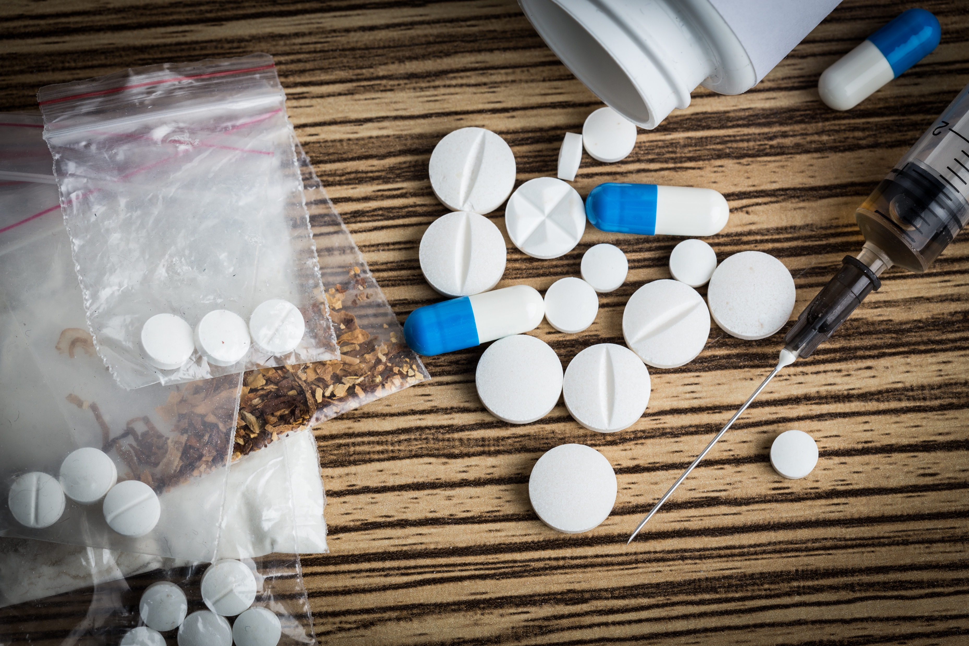
Detrimental Effects of Opioids
Notes:
Opioid use can also have many detrimental effects in the short and long term, including tolerance and dependance
Tolerance ccurs when increasing dosing is required to achieve the same effect. And dependence causes distressing withdrawal symptoms to occur once the drugs is stopped
Both of these can contribute to the development of opioid use disorder, also known as opioid addiction
Physicians need opioids to treat pain, but careful monitoring is needed to prevent misuse an addiction
3

Slide 4

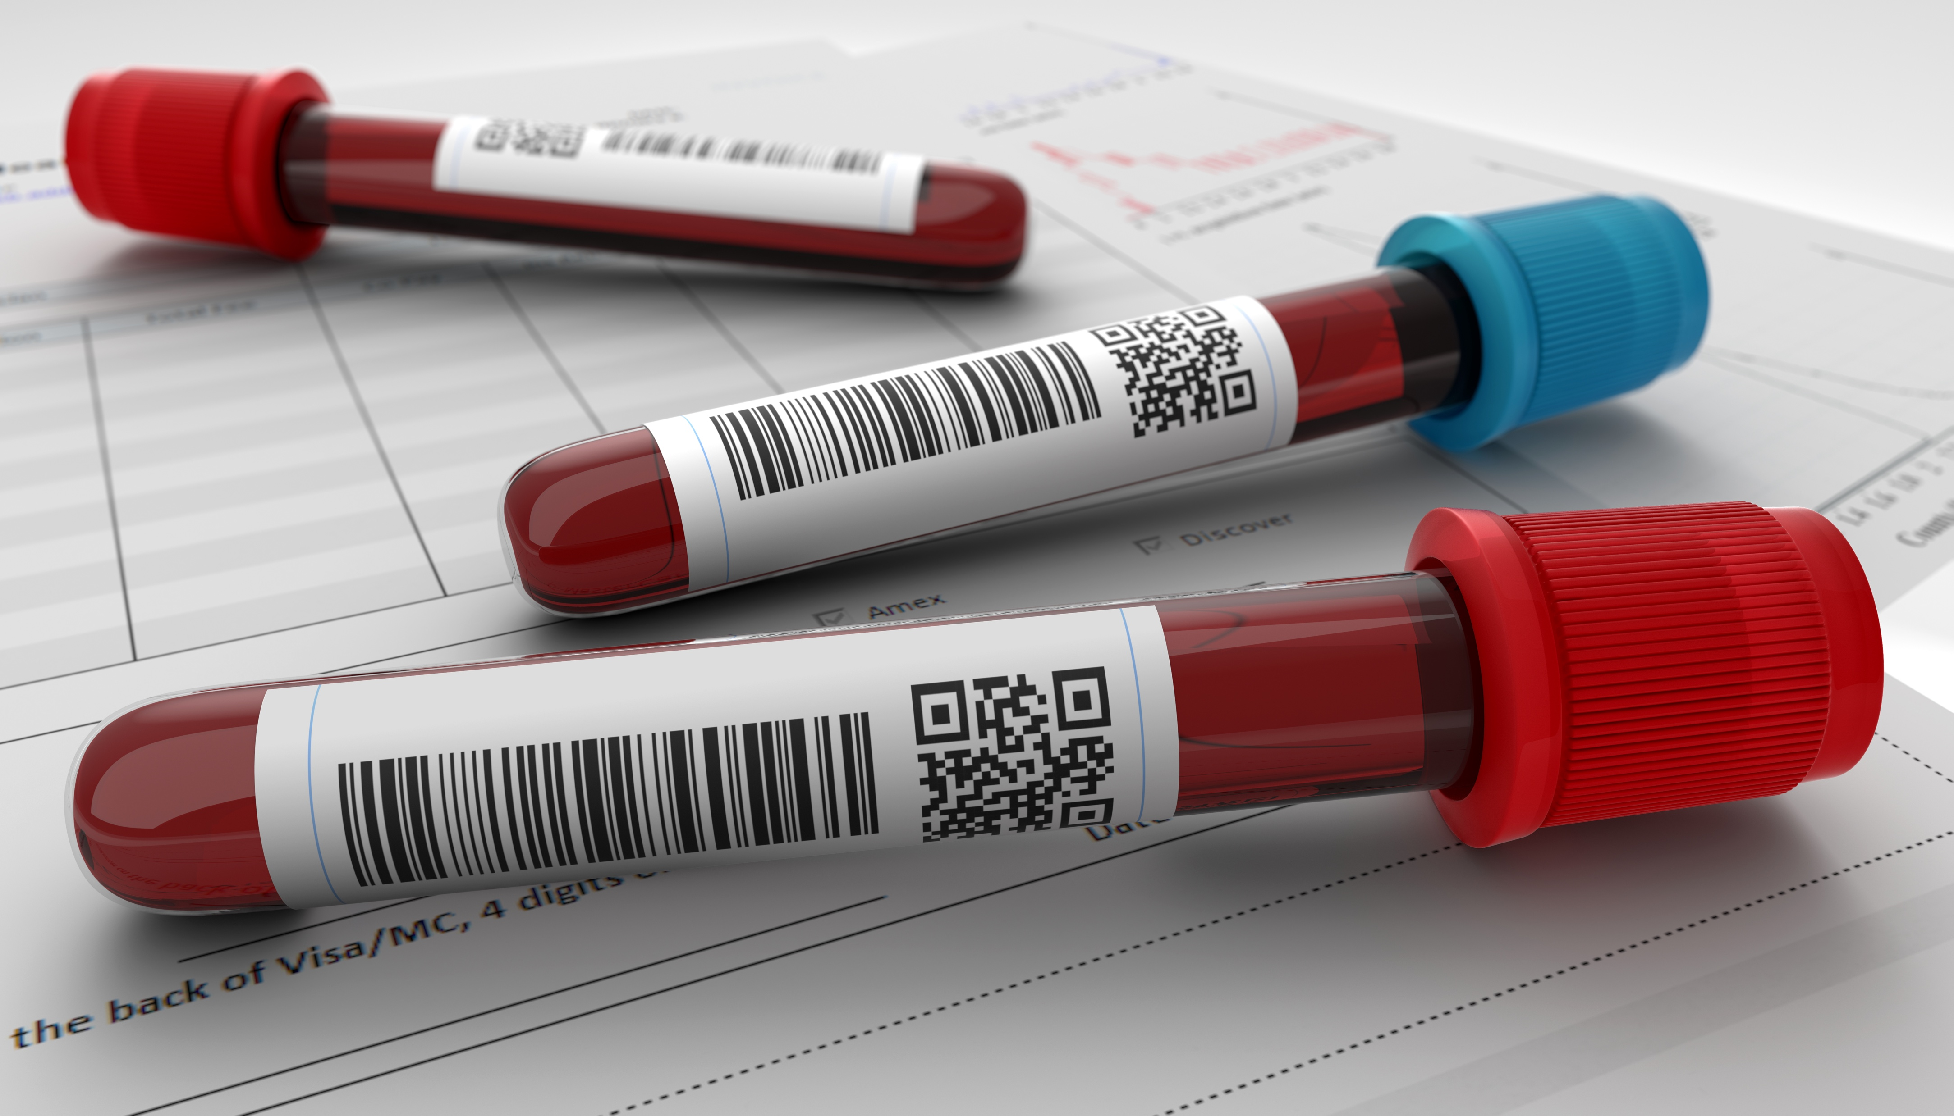
Current SOTA opioid monitoring
Self Report
- Recall-bias
- Intentional mis-representation
Blood and Urine testing
Limited detection window
- No information about timing, dose, or pattern
Notes:
The current state of the art methods for monitoring opioid use are self-report and biologic sample testing
Self-report suffers from inaccuracies due to recall bias and intentional concealment of use
Biological sample testing (such as urine, blood or hair testing) suffer from limited windows of detection, and an inability to provide information about timing and dose patterns.
4

Slide 5
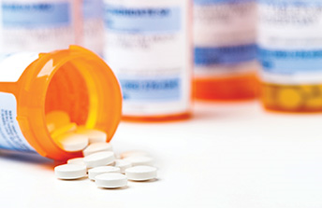
No objective measure exists to monitor opioid use (or misuse) in real-time.
Notes:
Currently, no objective measure exists to detect opioid use in real-time

Slide 6

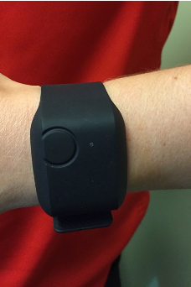
Opi-Track- In Hospital Field Study Design
Accelerometer
Skin Temperature
Electrodermal
Activity
Interbeat Interval
Heart rate
Hospital patients receiving IV opioids
Empatica (E4) wristband
Notes:
We propose OpiTrack, a wearable sensor based system to passively and objectively detect opioid use in real time.
As a preliminary step, we conducted a field study to monitor opioid use in a hospital setting. A total of 36 hospital inpatients were recruited to participate. Subjects received intravenous opioid analgesics at their physicians’ discretion, and were asked to wearing the Empatica E4 wristband throughout their entire hospital stay. The E4 is a medical grade device which continuously captures accelerometry, skin temperature, ectodermal activity, and heart rate signals. Ground truth data for occurrence and timing for opioid administrations was obtained via participant report and the electronic medical record
6

Slide 7
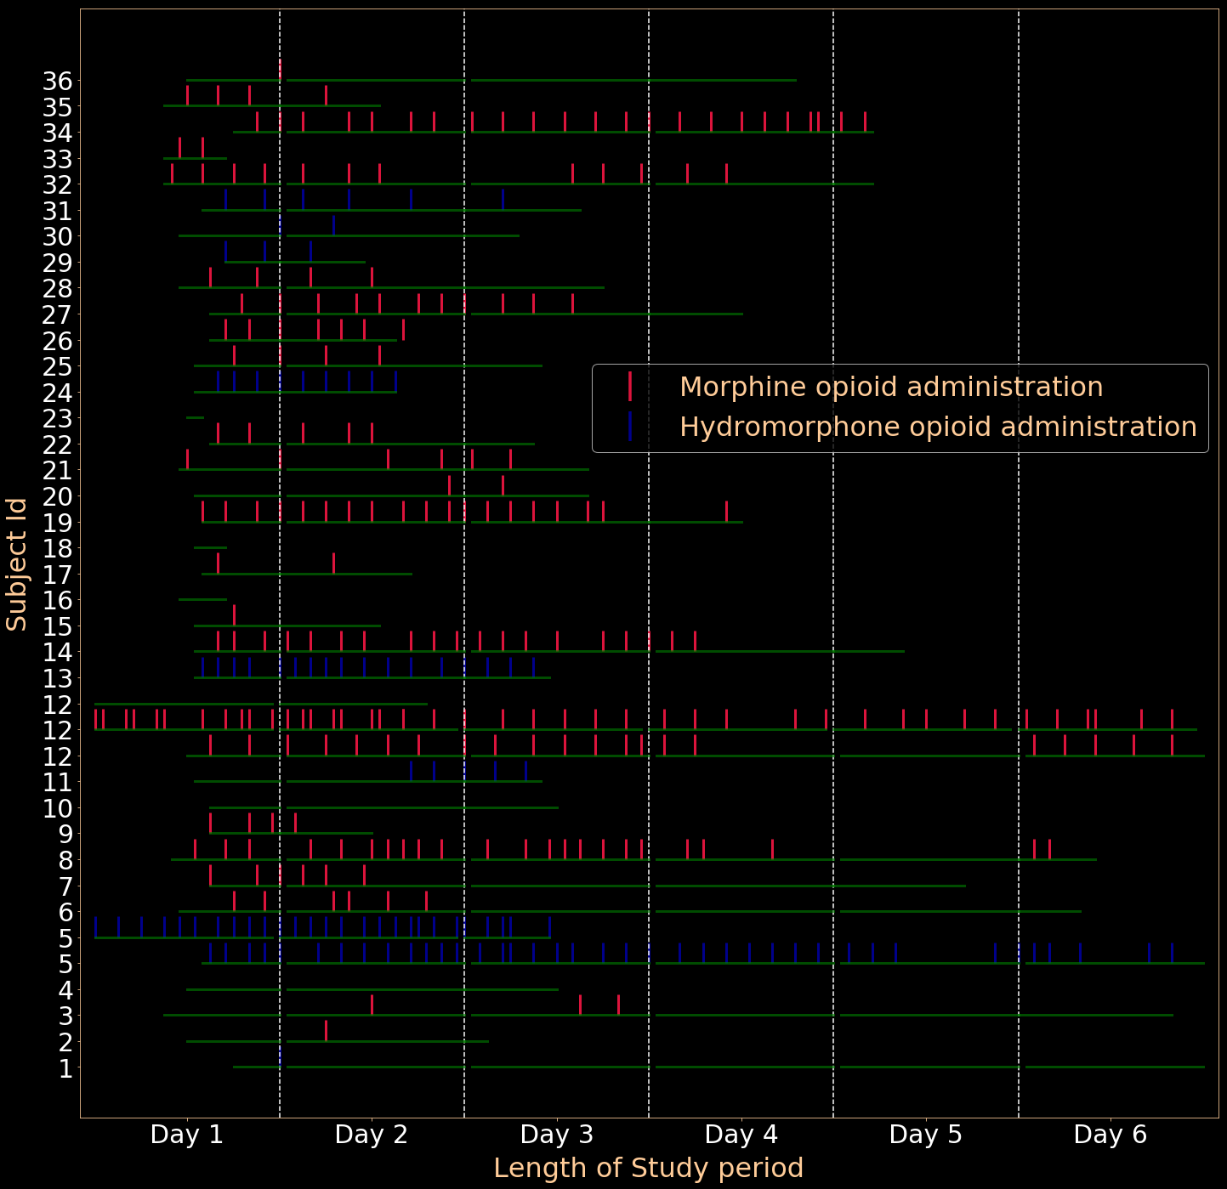
User Study
Total Administrations
339 IV administrations
2070 Hours
Notes:
A total of 2070 hours of data from the E4 was obtained, which included 339 opioid administrations.
7

Slide 8
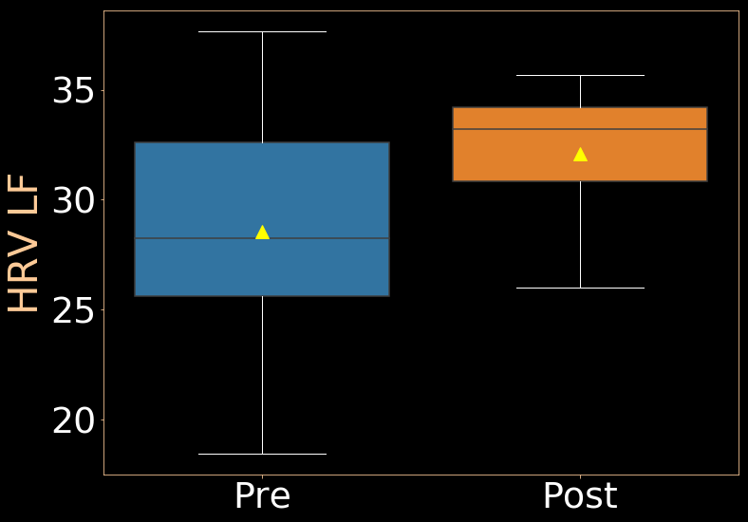
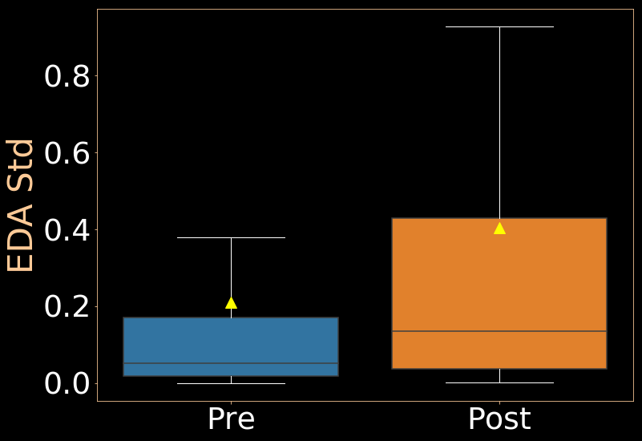
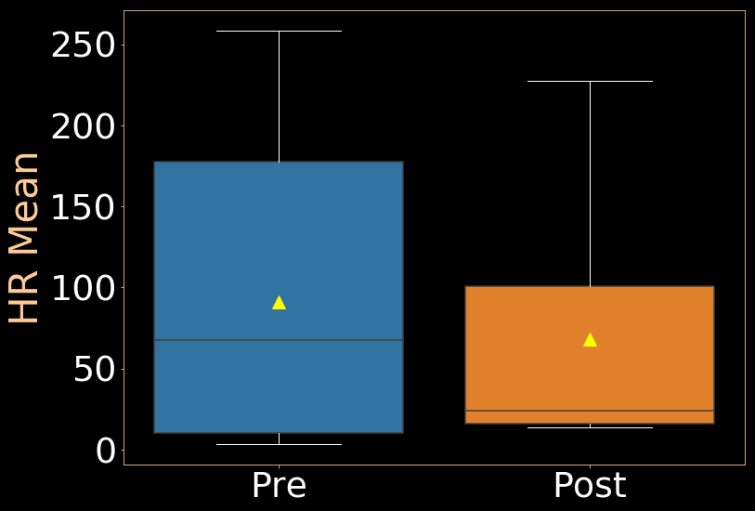
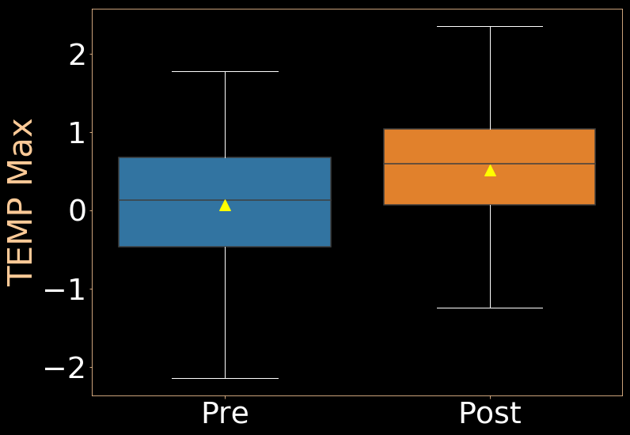
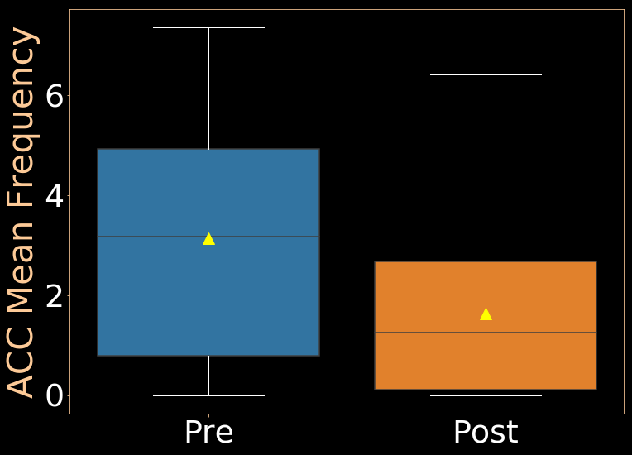
Physiological changes associated with opioid administration
Notes:
Before we try to model the physiological signals to detect opioid administration, we wanted to see if the wrist-worn sensor is sensitive to register physiological changes associated with opioid administration and whether these changes are statistically significant. We performed a paired-t-test analysis between physiological signals by applying different statistical functions and observed several of these are statistically significant.
This experiment established a confidence that we could indeed detect administration events.

Slide 9
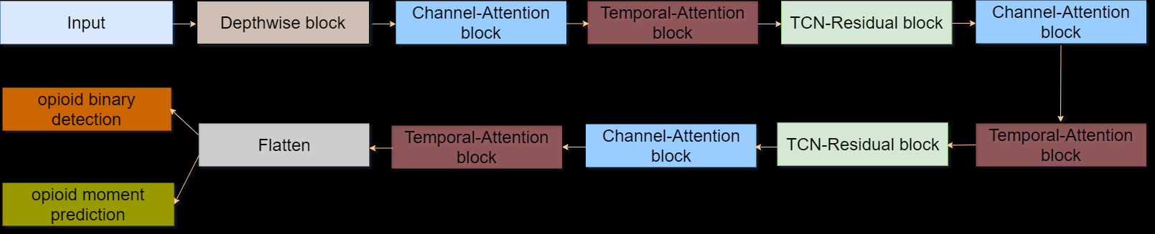

Channel-Temporal Attention TCN (CTA-TCN)
Notes:
Following is the channel-temporal attention TCN architecture used for jointly predicting opioid administration and opioid moment detection. Given physiological signal information of multiple modalities from a time-window, our model detects if an opioid administration occurred in this time-window or not and If an administration is detected, it then predicts the exact moment (time-minute) of administration in this time-window.
The design of this architecture has been motivated by previous statistical findings and observations. There are 4 main components to this architecture

Slide 10
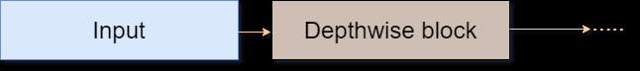
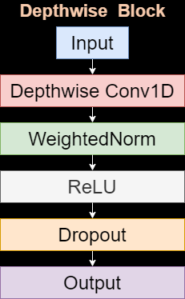
Depthwise block
Depthwise block extracts features from each modality separately to capture unique modality-specific trends .
Notes:
The input to the model is a time-windowed multimodal physiological signal. While performing paired t-test analysis, we observed different features from different modalities showed different trends during an administration. To capture these unique modality-specific trends, our model at first uses Depthwise convolution to extract features from each modality separately. Going forward, we use convolutions which capture cross-modality interactions.

Slide 11

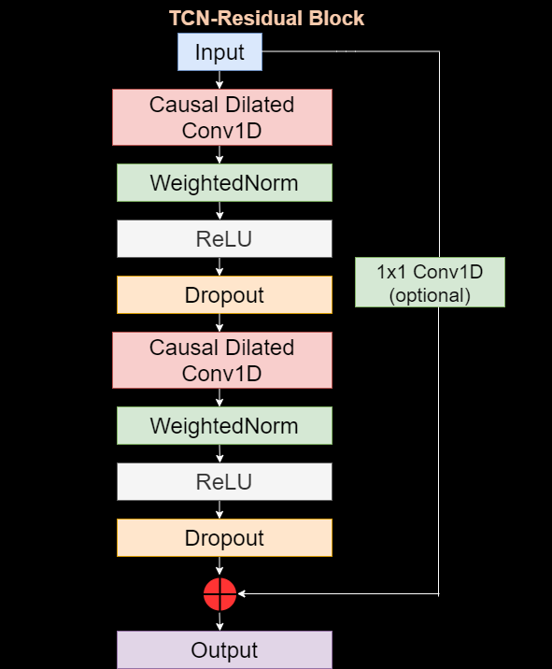
TCN block
100 Minute
Physiological signal
Causal dilated convolutions allow the receptive field of model to grow exponential of depth.
Notes:
A relatively large time-sequences as input is required for opioid use modeling due to the inherent time delay for the opioid to metabolize in the body. To consider such large input time-sequences we use TCN architecture. TCN’s are a combination of RNN’s and CNN’s, the key characteristic of TCN are causal dilated convolutions. These convolutions allow the receptive field of model to grow exponential of networks depth allowing the model to capture larger time-sequences.

Slide 12
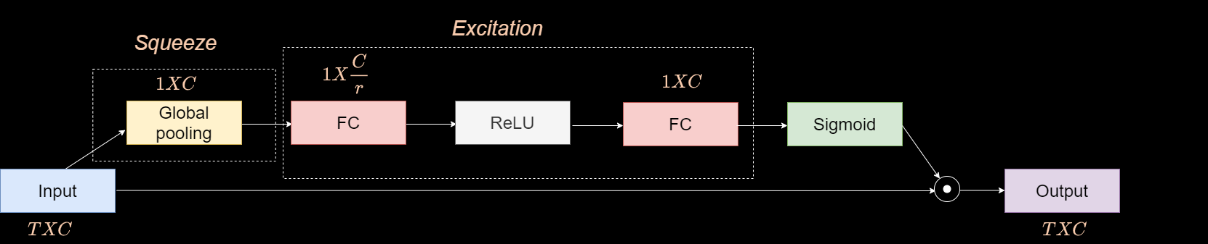
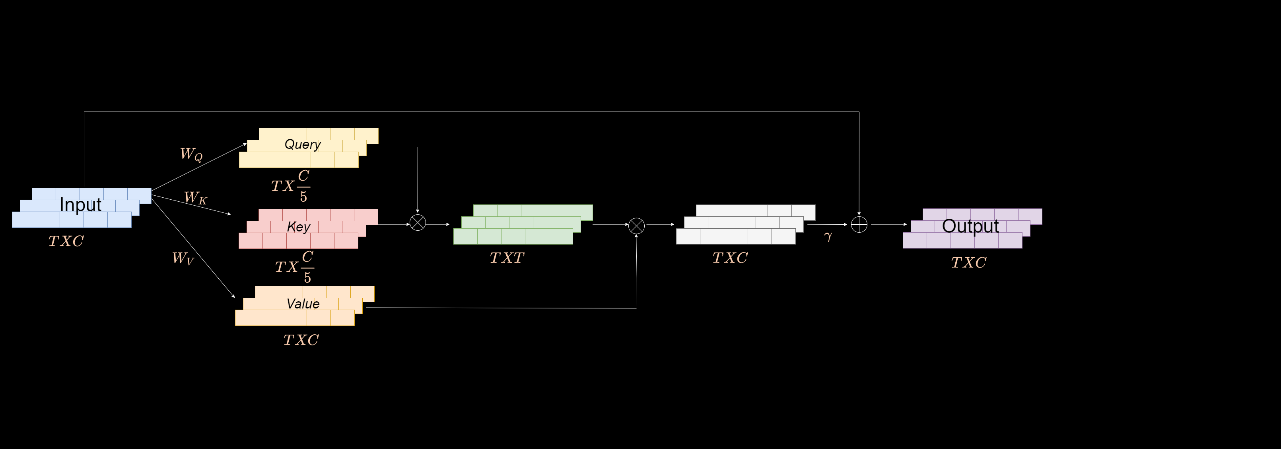
Attention blocks
Channel-Attention Block (SE)
Temporal-Attention Block
Notes:
To weigh the contributions of different modalities, we use a channel-attention block and to aid the model in attending to only the important time points we use a temporal-based self-attention block. Please refer to our paper for more information about these blocks.

Slide 13
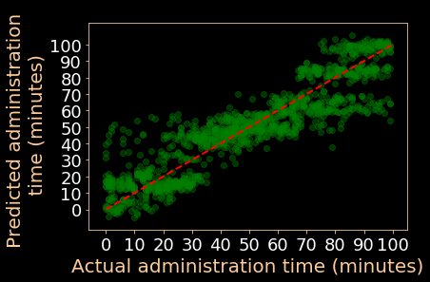
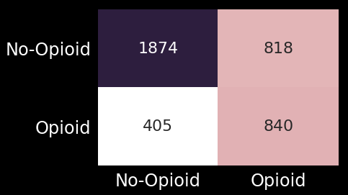
Opioid detection and moment prediction
Actual opioid
administration
Predicted opioid administration
Opioid moment prediction
Weighted F1= 0.8 ± 0.1
NMAE= 8.6 ± 2.4 Minutes
Notes:
Coming to the results, for the opioid administration detection which is a binary classification, following is the combined confusion matrix from LOSO, we got mean weighted F1-score of 0.8
For opioid moment prediction, following is the scatter plot between actual administration time and predicted administration, we got mean NMAE of 8.6 mins

Slide 14
Performance in Males is slightly better than Females
NMAE
F1-score
Specificity
Sensitivity
Male
8.67
0.82
0.79
0.78
8.63
0.75
0.70
0.77
Female
All participant distribution
Opioid administrations
distribution
Notes:
We next broke down the performance of our model across different demographic groups. We observed that while the model in general performed well in both Female and Male, it is slightly better in males. We consider this result with caution, as the reason might be females having more opioid administration while having a smaller dataset size in our case.

Slide 15
Performance is uniform across all BMI categories
NMAE
F1-score
Specificity
Sensitivity
Normal
9.31
0.79
0.76
0.78
Overweight
8.07
0.80
0.77
0.80
7.73
0.81
0.79
0.79
Obese
Notes:
Across different BMI categories , the model performed uniformly. Previous studies had shown to indicate relatively similar pharmacokinectics irrespective of the BMI ranges.

Slide 16
It is easier to detect administrations in Naïve participants
NMAE
F1-score
Specificity
Sensitivity
Naive
7.97
0.82
0.79
0.79
Occasional
9.23
0.82
0.78
0.78
9.02
0.76
0.72
0.78
Chronic
Notes:
Repeated opioid exposure can lead to opioid tolerance, requiring as a result higher amount of dosage to reach certain effect. We observed that it is easier to detect in participants who previously had no exposure to opioid as compared to participants who are chronic users.

Slide 17
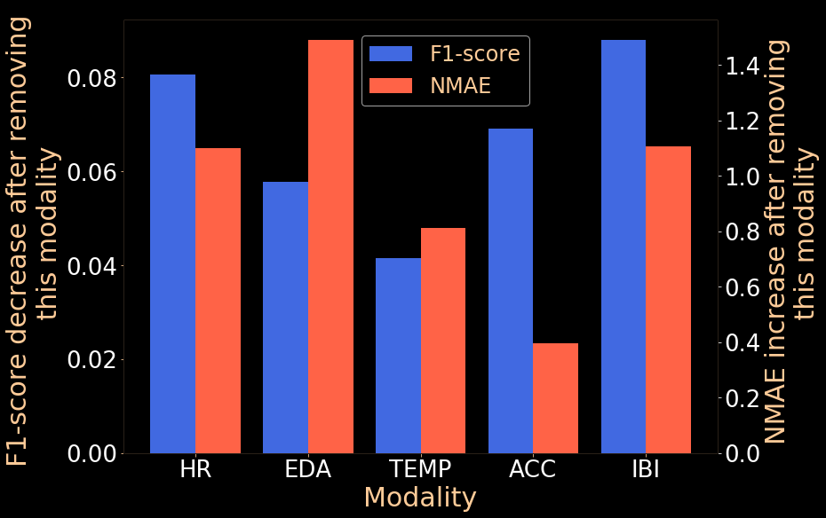
Heart-rate associated signals contribute the most
Notes:
Next, we did an ablation-based study to observe the importance of different physiological signals. To find the importance of a modality, we removed it from all the inputs and retrained the model with the remaining modalities. Our hypothesis is that the decrease in performance reflects the modality’s importance. We observed that HR and IBI signals contributed the most for opioid administration detection and HR,EDA and ACC contributed the most for moment prediction. Skin temp was the least important for both the cases , we believe this is due to inconsistent nature of opioids to cause variable degree of increase and decrease in temperatures after administration.

Slide 18
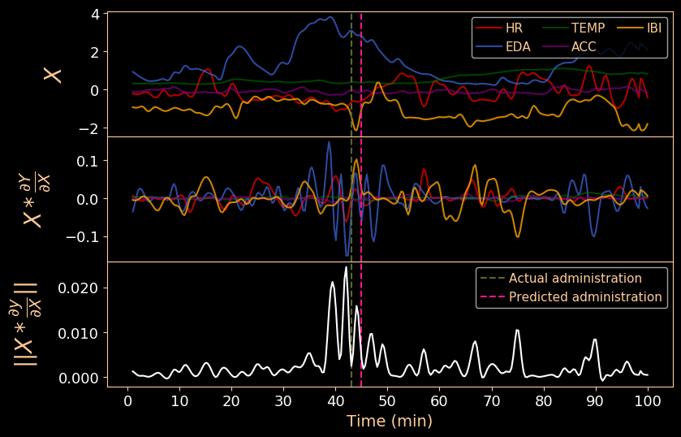
Explaining predictions
Notes:
While the feature relevance analysis was able to show the overall importance of different modalities, next we wanted to investigate how our model placed importance on different modalities and time instances for individual predictions, for this we apply a backpropagation based attribution method called Gradient*input in which we compute the importance of the input features by taking the partial derivatives of output with respect to the input and multiplying this by the input itself.
Consider the following example –
The first subplot shows the input signal
The second subplot shows the output of Gradient*input method, this gives an overview of the importance of different modalities
The third subplot shows the importance of different timepoints
In this case, EDA,IBI, HR signals contributed the most.
Please refer to our paper for more examples and detailed explanations.

Slide 19

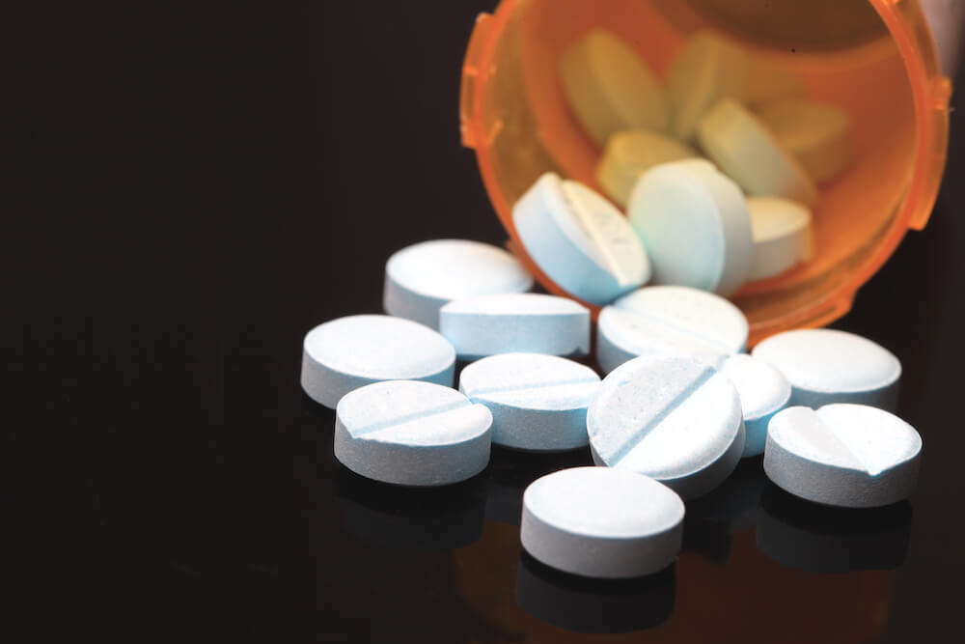
What’s next ?
IV administrations
Oral administrations
Notes:
Going forward , we are actively exploring 2 directions
1)Can we detect opioid administrations taken orally, and if so , what are physiological differences between IV and oral administrations

Slide 20
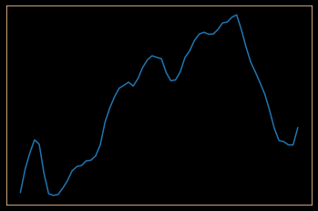
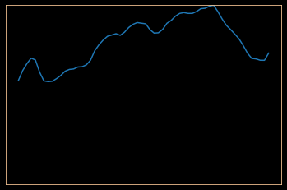

What’s next ?
Heart rate
Heart rate
……
……..
Time
Longitudinal changes in subject's physiological signals
due to opioids.
Notes:
2) Can we identify the longitudinal effects of opioids on physiological signals in a large population

Slide 21

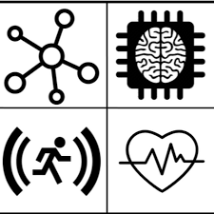


Thank You
Notes:
That concludes our work, thank you very much.

